Slide 1
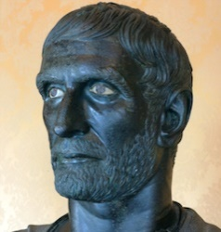
Classics/History 37A - Early Rome Winter 2017
The Conquest of Italy
January 31

Slide 2

Sources
Livy (c. 64 BCE - 12 CE)
Dionysius of Halicarnassus (c. 60 - after 7 BCE)
Polybius (c. 200-118 BCE)
Cassius Dio (c. 155-235 CE)

Slide 3
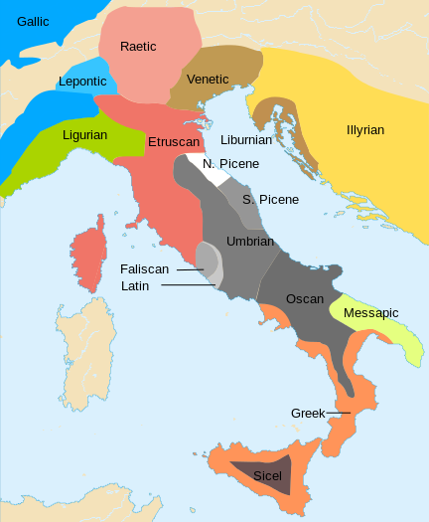
Ancient Italian Languages
Etruscan
Italic languages
Oscan
Umbrian
Faliscan
Latin
Greek
Languages of Italy, c. 650 BCE

Slide 4
Rome’s Neighbors
Sabines
Latins
Lavinium
Gabii
Volscians
Etruscans
Veii
Caere
Volsinii
Clusium
Gauls
Samnites
Greeks

Slide 5
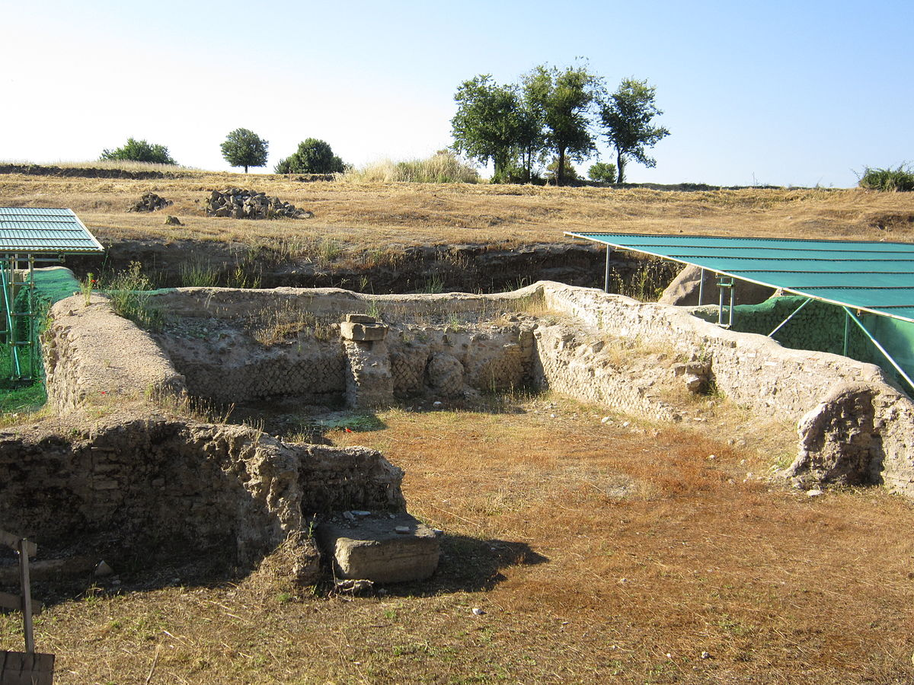
The Latin League
Military alliance of Latin cities with Rome
Supposedly founded after the exiled Tarquinius Superbus led the Latins against Rome
Defeated at Lake Regillus in 493 BCE
Formalized as the Foedus Cassianum (‘treaty of Cassius’)
Romans and Latins founded joint colonies that became independent members of the League
The Ruins of Gabii

Slide 6
Foedus Cassianum
*
“Let there be peace between the Romans and all the Latin cities as long as the heavens and the earth shall remain where they are. Let them neither make war upon another themselves nor bring in foreign enemies nor grant a safe passage to those who shall make war upon either. Let them assist one another, when warred upon, with all their forces, and let each have an equal share of the spoils and booty taken in their common wars. Let suits relating to private contracts be determined within ten days, and in the nation where the contract was made. And let it not be permitted to add anything to, or take anything away from, these treaties except by the consent both of the Romans and of all the Latins.”
- Dionysius of Halicarnassus, Roman Antiquities 6.95.2

Slide 7
The Volscians
People living in central Italy, south of Latium
Allies, then enemies of the Latins
Attacked by the Romans in the 490s BCE
Attacked Rome in 488, apparently under the leadership of Coriolanus, an exiled Roman general

Slide 8
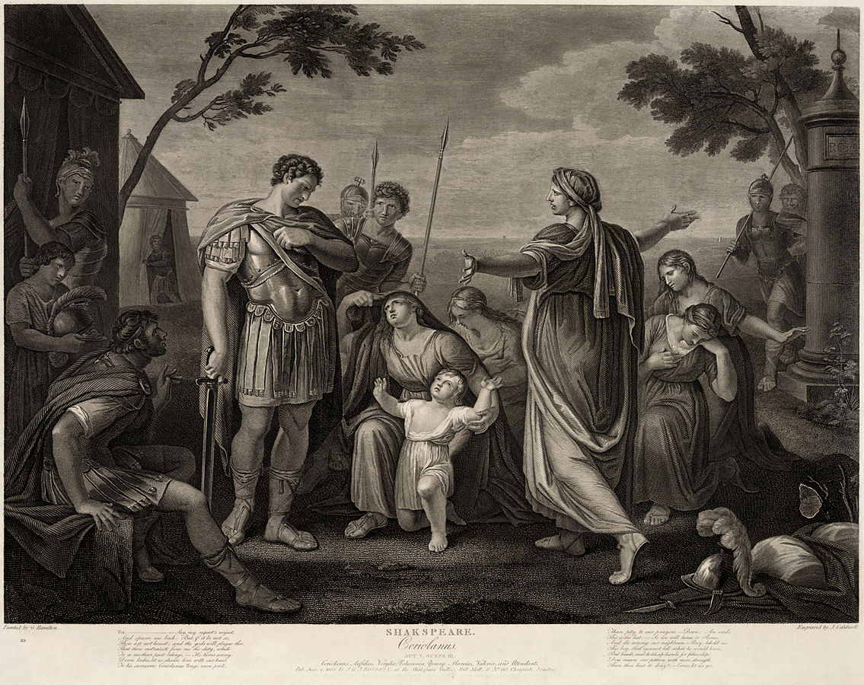
Coriolanus

Slide 9
Roman Expansion
Joint colonies
Roman annexations
Fidenae (426 BCE)
Labici (418 BCE)
Veii (396 BCE)
Tusculum (381 BCE)

Slide 10
The Gauls
Celtic inhabitants of Cisalpine Gaul in northern Italy
Raided northern Etruria, and established a base at Clusium
According to Livy, they wanted Italian wine
Defeated the Romans at the Allia in 390 or 387 BCE
Sacked Rome three days later

Slide 11
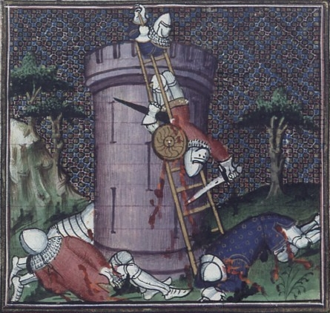
The Sack of Rome
Romans retreated to the Capitoline Hill
Gauls climbed the hill at night
Sacred geese at the temple of Juno started squawking, alerting Marcus Manlius
Romans eventually paid the Gauls to leave

Slide 12
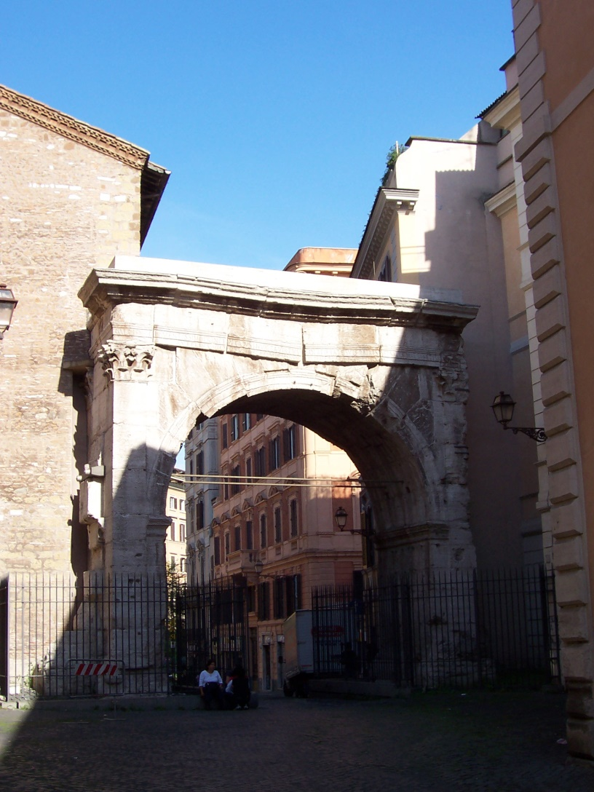
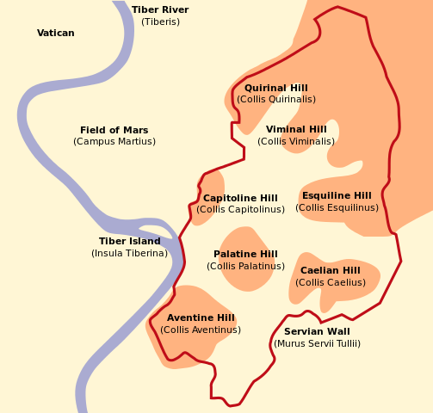
The Servian Wall
c. 376 BCE
The Porta Esquilina

Slide 13
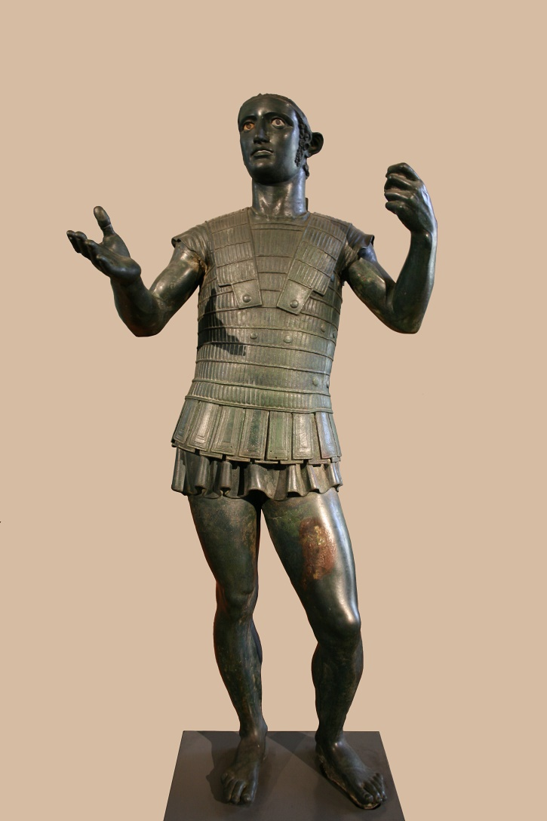
Conquest of the Etruscans
Veii (396 BCE)
Fighting near Sutrium and Tarquinii (389-386 BCE)
Caere and Tarquinii (359-351 BCE)
Final defeat at Lake Vadimo in 283 BCE
But Livy is our only source for most of this!
‘Mars of Todi,’ c. late 5th – early 4th cen. BCE

Slide 14
Treaty with Carthage (348 BCE)
*
“There is to be friendship on these conditions between the Romans and their allies and the Carthaginians and Uticans and their allies…And if the Carthaginians take any city in Latium which is not subject to the Romans, they may keep the property and the captives but must surrender the city. And if a Carthaginian captures anyone who is a member of a community with a written agreement with Rome, but not subject, he may not bring him into any Roman harbor; if he does, a Roman may touch him and free him.”
- Polybius 3.24.3

Slide 15
The Latin Revolt
Latin League revolted against Roman rule in 341 BCE
Defeated by the Romans in 338 BCE
League dissolved, and former members granted ‘Latin rights’

Slide 16
Latin Rights
Commercium
Right to own Roman land, slaves, cattle, and to inherit from Romans
Conubium
Right to intermarry with Roman citizens
Ius migrandi
Right to live in Roman territory

Slide 17
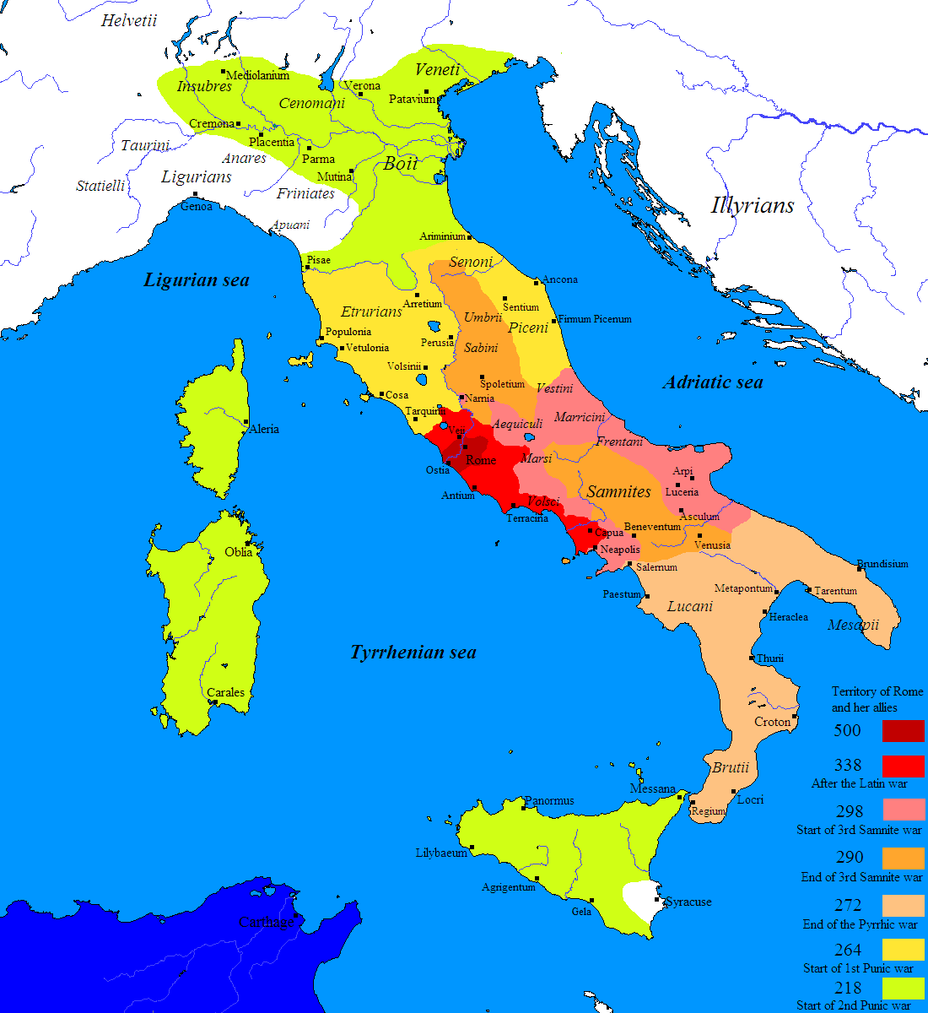
The Samnites
First Samnite War (343-341 BCE)
Response to Capuan request for help
Second Samnite War (326-304 BCE)
Response to Neapolitan request for help
Roman surrender at the Caudine Forks, 321 BCE
Ended in a peace treaty
Battle of Sentinum (295) BCE
Coalition of Samnites, Gauls, Etruscans and Umbrian

Slide 18
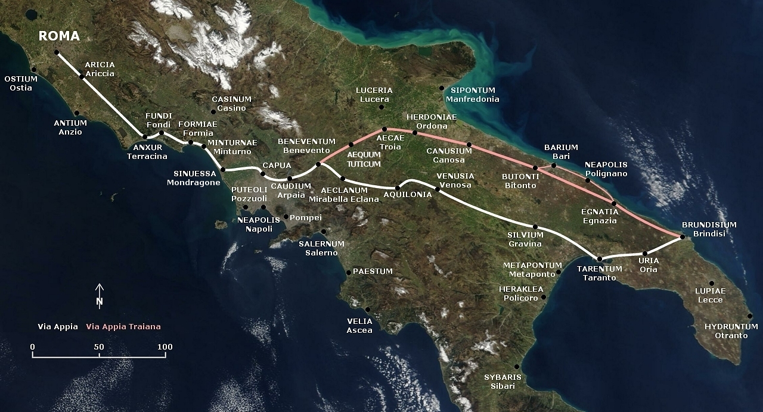
The Via Appia
*
Luceria (314 BCE)
Venusia (291 BCE)
Beneventum (268 BCE)
Aesernia (263 BCE)
Via Appia, begun by Appius Claudius Caecus in 312 BCE during the Samnite Wars

Slide 19
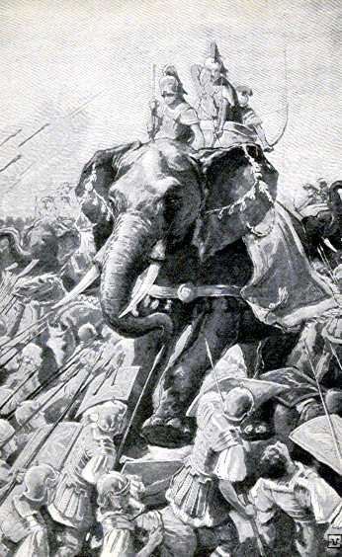
War with Pyrrhus
King of Epirus in Greece (306-302, 297-272 BCE)
Asked by Tarentum in Magna Graecia for help against Rome (281 BCE)
Costly victories against the Romans at Heraclea (280) and Asculum (279); finally defeated at Maleventum (275)

Slide 20
War with Pyrrhus

Slide 21
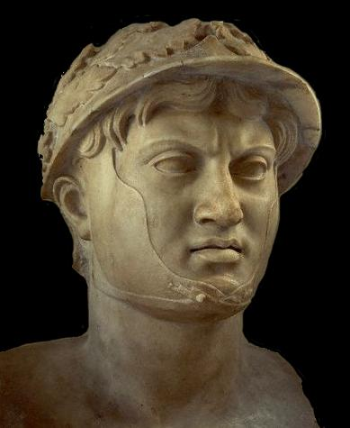
‘Pyrrhic’ Victory
“If we are victorious in one more battle with the Romans, we shall be utterly ruined.”
King Pyrrhus, after the Battle of Asculum (279 BCE)
*

Slide 22
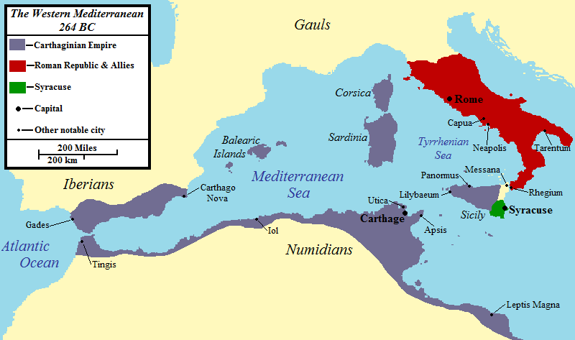
The Carthaginians…

Slide 23
Why?
Fear
Consuls
Population

Slide 24
Fear
Sabines
Latins
Lavinium
Gabii
Volscians
Etruscans
Veii
Caere
Volsinii
Clusium
Gauls
Samnites
Greeks

Slide 25
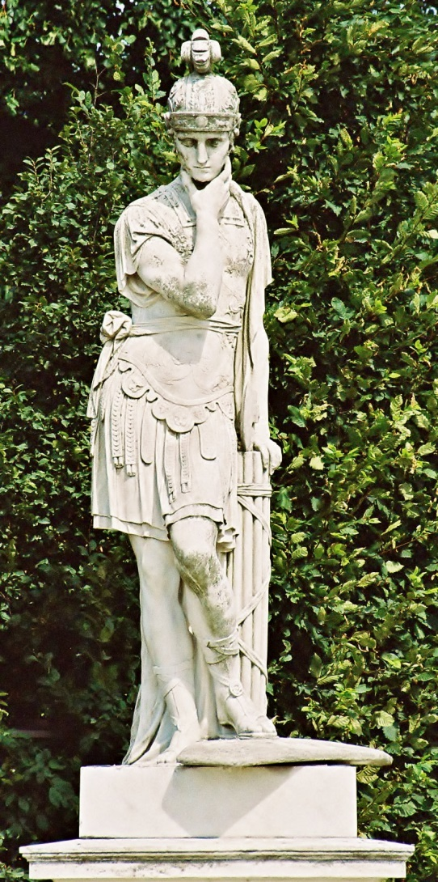
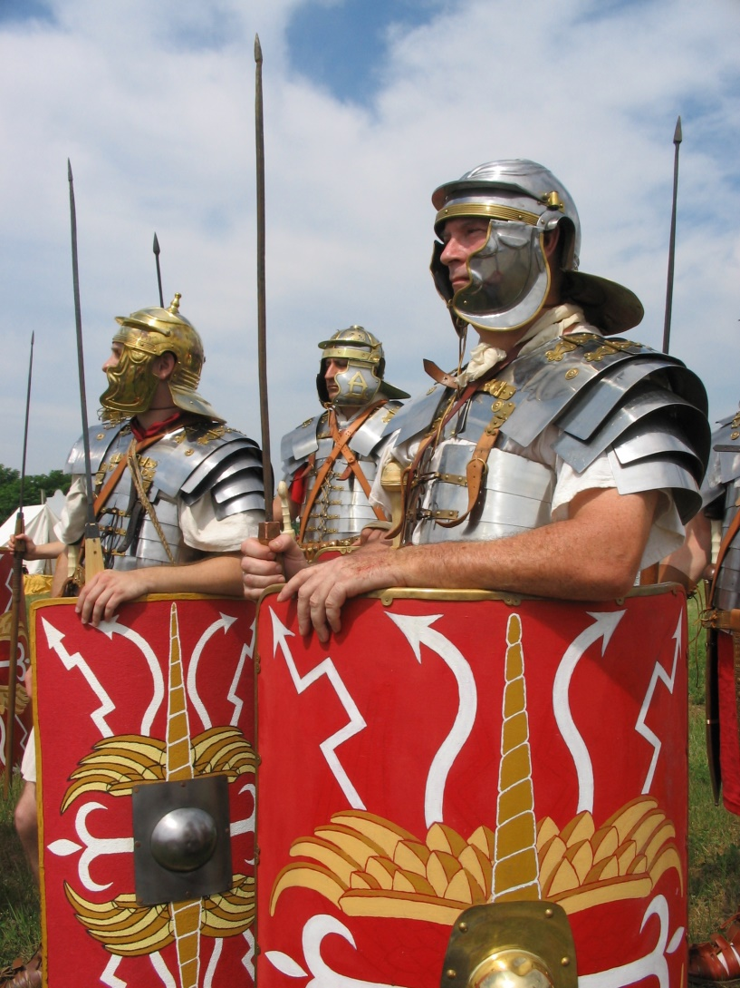
Consuls and Population
Quintus Fabius Maximus Verrucosus Cunctator (cos 233, 228, 215, 214, 209 BCE)
Roman Legionary Reenactors

Slide 26
Key Terms
Colony
Latin League
Foedus Cassianum
Volscians
Veii
Gauls
Latin Rights
Samnites
Via Appia
Pyrrhus

